Slide 1

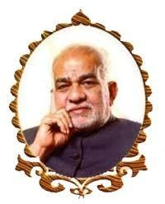
BVRIT HYDERABAD College of Engineering for Women Department of Computer Science and Engineering
REVIEW - 4
Automated Generation of Challan by Detecting Helmet
29-04-2023
Team No: B5
19WH1A05C0 – Ms. S. S. Sphoorthy
19WH1A0597 – Ms. K. Chandralekha
20WH5A0508 – Ms. A. Swathi
Under the guidance of:
Name: Mr. R. Dileep Kumar
Designation: Assistant Professor

Slide 2
AGENDA
Abstract
Introduction
Objective
Literature Survey
Existing system
Proposed system
Architecture
Methodology
Dataset
Results
Societal Impact
Conclusion
References

Slide 3
ABSTRACT
Despite numerous traffic rule violations such as riding without helmets, drunk driving, overloading of vehicles with triple seats, and frequent accidents, traffic police have been deployed on every square to control the traffic. However, monitoring every violation has become a daunting task for the traffic authorities. To address this issue, a solution has been proposed using neural networks to develop an E-Challan Generation System. This will enable the traffic police department to easily identify violators without helmets and allocate more resources to monitor other violations.

Slide 4
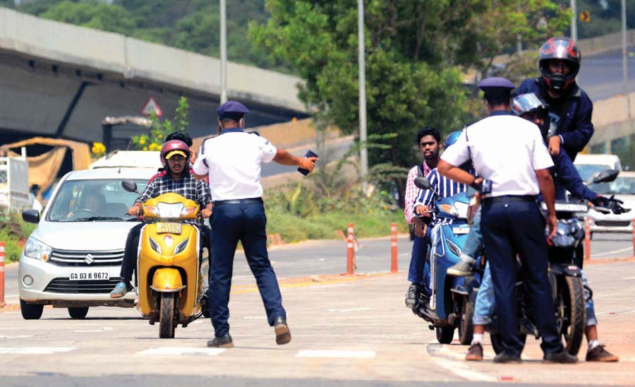
INTRODUCTION
The task of enforcing vehicle laws has become increasingly difficult due to the growing number of vehicles on the road.
Detection and tracking of traffic violations have been a challenging process, despite tremendous automation in detection and issuance of challan.

Slide 5
INTRODUCTION
The demand for a transparent, quick and hassle-free traffic violations management systems with the support of E-challan has been the need of the day in vast countries with large number of motor vehicles.
Many methods have been proposed to detect and extract the licence plate. However, due to poor image quality and non-uniform illumination, it becomes a difficult task.

Slide 6
OBJECTIVE
The objective of the project is to design and implement an automated system that can generate E-Challan by accurately identifying users who are riding without helmets and extracting their vehicle number.

Slide 7
LITERATURE SURVEY
S. No | Title of the paper | Author(s) & Journal Details | Description/ Interpretation
1. | Automated Generation of Challan on Violation of Traffic Rules using Machine Learning | Shubham Kumar Chandravanshi, et al. & IJSR | Generates E-Challan by using Yolo (You Only Look Once) algorithm.
2. | Online Challan Generation System Based On Machine Learning | Sonali Ridhorkar, et al. & IJIES | It is a E-Challan generating system that uses CNN, KNN (K-Nearest Neighbour).
3. | Smart Vehicle Recognition And E-Challan Generation System | Raghunandan Srinath, et al. & INCET | The system uses chassis number(VIN) to generate E-Challan.

Slide 8
LITERATURE SURVEY
S. No | Title of the paper | Author(s) & Journal Details | Description/ Interpretation
4. | Cognitive Number Plate Recognition (CNPR) using Machine Learning and Data Visualization Techniques | Rahul Agarwal, et al. & ICSC | This is a CNPR based system that performs analysis using data clustering methods.
5. | Smart Vehicle Number Plate Scanning System using Optical Character Recognition Strategy | M. Rajkumar, et al. & ICCMC | Recognition of number plate system using INC (Intelligent Neural Classifier) algorithm to verify whether a vehicle is legal or not.
6. | Recognition of Moving Vehicle Number Plates using Convolutional Neural Network (CNN) and Support Vector Machine Techniques (SVM) | Roshan Fernandes, et al. & DISCOVER | A licence plate recognition System that uses CNN and SVM techniques.

Slide 9
LITERATURE SURVEY
S. No | Title of the paper | Author(s) & Journal Details | Description/ Interpretation
7. | Licence Plate Identification and Recognition for Non-Helmeted Motorcyclists using Light-weight Convolutional Neural Network | Meghal Darji, et al. & INCET | It is a recognition system that extracts licence plate number of two-wheelers who do not wear helmets.
8. | E-challan Generation Using ANPR with Web Application | Shubham Kumar Sharma, et al. & IRJMETS | An ANPR based system that sends SMS to the violator immediately and generates challan using web application.
9. | IoT based E-Challan Automation for RTO using RFID | Siddhant Shivam, et al. & IRJET | It is an IOT based system that generates E-Challan using RFID (Radio-Frequency Identification) technology.

Slide 10
LITERATURE SURVEY
S. No | Title of the paper | Author(s) & Journal Details | Description/ Interpretation
10. | Automatic challan System using RFID Technology | Manish Kumar, et al. & JNCET | Deploys the RFID technology that comprises tags storing and transferring over a wireless interface.
11. | Automated E-Challan System | Shubham Kukde, et al. & IJRASET | In this system the offender gets notified about the challan through SMS.
12. | A Review Paper on Vehicle Number Plate Recognition | Sharmishtha Mohite, et al. & JJERT | This system detects the image of the number plate from video using raspberry pi and OCR technique.

Slide 11
EXISTING SYSTEM
In the existing system, traffic police takes a photo of the licence plate of the offenders who violate the traffic rules. Then E-challan is generated and sent to the associated challan website using the vehicle information retrieved from the concerned authorities.
The authors in the literature used machine learning to recognize the vehicle number in the considered image to achieve the proposed task.

Slide 12
EXISTING SYSTEM
Drawbacks:
The problem with the existing system is that, it generates challan manually where traffic authority captures the images of number plates.
This system is not efficient since it is both time and effort consuming.

Slide 13
PROPOSED SYSTEM
The proposed system presents automated generation of challan for ease of use and to improve efficiency in processing.
The system considers image processing in an automated way which serves for object detection.

Slide 14
PROPOSED SYSTEM
The objective of this project is to design an efficient deep learning mechanism that utilizes SSD MobileNet to process images and accurately identify objects extracted from the image processing.
This prototype makes it easy for traffic authorities to reduce human error that exists in the current system.

Slide 15
ARCHITECTURE
Helmet Not Detected
Helmet Detection
Input Image
Image Processing
Helmet Detected
Vehicle Number Plate Detection
E-Challan Generation
Feature Extraction
Vehicle Number Plate Character Segmentation

Slide 16
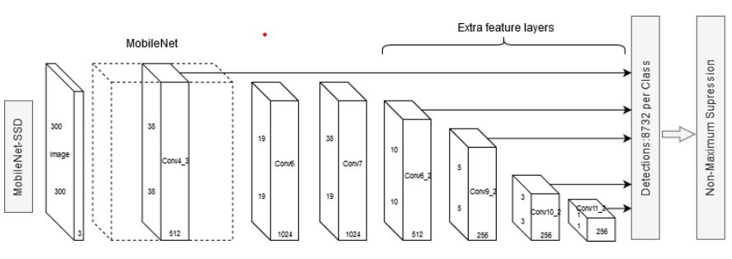

METHODOLOGY
MobileNet SSD Architecture

Slide 17
METHODOLOGY
MobileNet SSD is a specific implementation of a CNN model that detects object and computes the output bounding box and object class from the input image.
This Single Shot Detector (SSD) model takes only one shot to detect multiple objects present in an image.
This model has 28 convolution layers, including depthwise and pointwise convolutions.

Slide 18
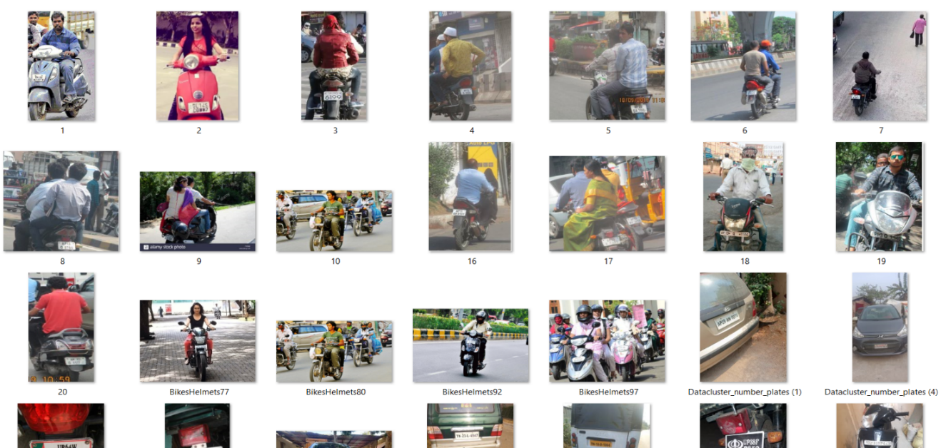
DATASET
https://www.kaggle.com/datasets/andrewmvd/helmet-detection?select=images
Dataset size: 259 MB
Dataset type: 385 Images

Slide 19
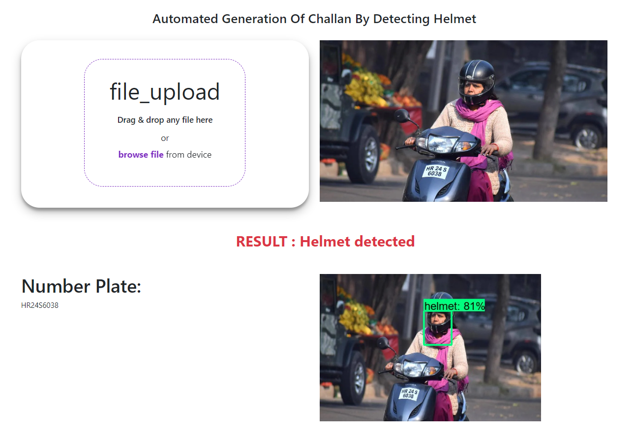
RESULTS

Slide 20
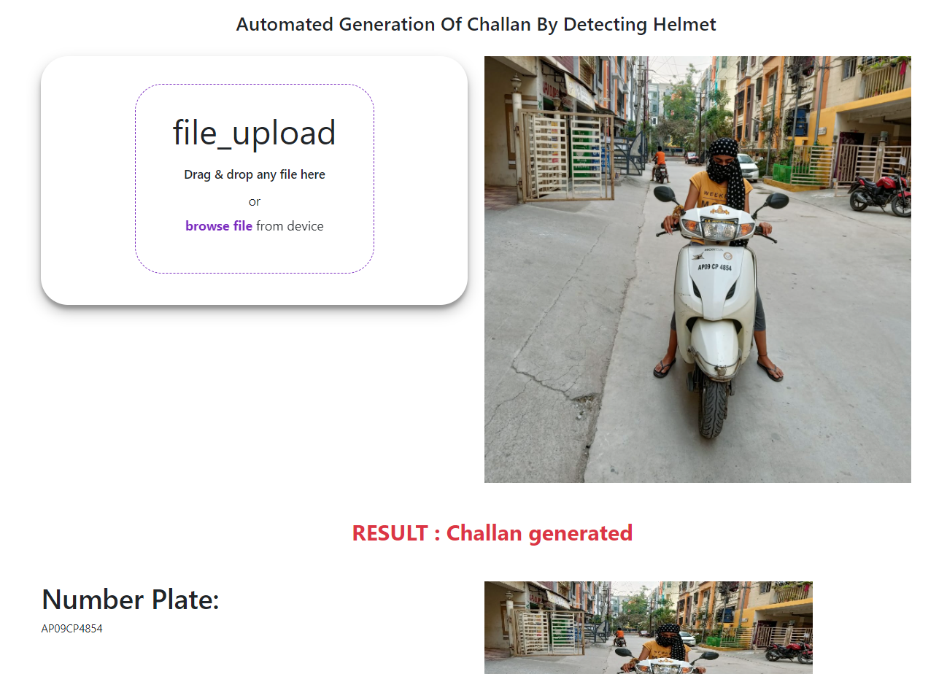
RESULTS

Slide 21
SOCIETAL IMPACT
In countries with a large population like India, road accidents are a significant concern. Riders without helmets are 2.5 times more likely to die in an accident than those wearing helmets.
To address this issue, a proposed system can be used to quickly detect drivers not wearing helmets and issue challans.
This system can also reduce the workload of traffic police officers, allowing them to focus on other violations such as illegal parking, driving on the wrong side, and drunk driving.

Slide 22
CONCLUSION
To conclude, using SSD MobileNet in deep learning is an effective way to detect helmets and identify number plates. This technology can help catch violators and improve road safety. This technology holds great promise for the future of traffic regulation and management. Further, the task of real time image processing for poor quality images can be carried out for this system as future scope.

Slide 23
REFERENCES
[1] Shubham Kumar Chandravanshi, Hirva Bhagat, Manan Darji, Himani Trivedi, ”Automated Generation of Challan on Violation of Traffic Rules using Machine Learning”, Volume 10 Issue 3, March 2021.
[2] Dr. Sonali Ridhorkar, Khushi Gupta, Kalyani lokhande, Prachi Bhanarkar, Vijeta Meshram, Venuhemane, ”Online Challan Generation System Based On Machine Learning”, Vol. 7, No. 8, 2022.
[3] Srinath, Raghunandan, Jayavrinda Vrindavanam, Y. R. Sumukh, L. Yashaswini, and Sangeetha S. Chegaraddi. "Smart Vehicle Recognition And E-Challan Generation System." In 2020 International Conference for Emerging Technology (INCET), pp. 1-4. IEEE, 2020.
[4] Agrawal, Rahul, Manas Agarwal, and Rajalakshmi Krishnamurthi. "Cognitive number plate recognition using machine learning and data visualization techniques." In 2020 6th international conference on signal processing and communication (ICSC), pp. 101-107. IEEE, 2020.
[5] Rajkumar, M., I. Chandra, S. Jai Ganesh, K. Dhivya, and K. Sangeethalakshmi. "Smart Vehicle Number Plate Scanning System using Optical Character Recognition Strategy." In 2022 6th International Conference on Computing Methodologies and Communication (ICCMC), pp. 1328-1334. IEEE, 2022.
[6] Fernandes, Roshan, K. Madhu Rai, Anisha P. Rodrigues, B. A. Mohan, N. Sreenivasa, and N. Megha. "Recognition of Moving Vehicle Number Plates using Convolutional Neural Network and Support Vector Machine Techniques." In 2021 IEEE International Conference on Distributed Computing, VLSI, Electrical Circuits and Robotics (DISCOVER), pp. 93-98. IEEE, 2021.

Slide 24
REFERENCES
[7] Darji, Meghal, Jaivik Dave, Nadim Asif, Chirag Godawat, Vishal Chudasama, and Kishor Upla. "Licence Plate Identification and Recognition for Non-Helmeted Motorcyclists using Light-weight Convolution Neural Network." In 2020 International Conference for Emerging Technology (INCET), pp. 1-6. IEEE, 2020.
[8] Sharma, Shubham Kumar, Aakrati Jain, Swapnil Babar, and Pushpak Mahajan. "E-CHALLAN GENERATION SYSTEM USING ANPR WITH WEB APPLICATION.“International Research Journal of Modernization in Engineering Technology and Science, Volume:03, Issue:04, April-2021, pp – (2265-2268)
[9] Siddhant Shivam, Tushar Teotia, Shubham Mishra, Himanshu Mittal, ” IOT based E-Challan Automation for RTO using RFID”, Volume: 06, Issue: 03, Mar 2019.
[10] Manish Kumar, Niranjan Kumar, Mizan Faisal, Nizamuddin, Niranjan Kumar, ” Automatic challan System using RFID Technology”, Volume 6, Issue 5, May 2019.
[11] Shubham Kukde, Sakshi Lokhande, Santosh Mishra, Pranoti Mahalle, Prof. Kiran, ”Automated E-Challan System”, Volume 7, Issue III, Mar 2019.
[12] Chinmayi Gurav, Vedika Kamble, Rupali Gurav, Prof. Neha S. Sakhalkar, ”A Review Paper on Vehicle Number Plate Recognition”, Vol. 8 Issue 04, April 2019.

Slide 25
THANK YOU

